Slide 1
Contemporary Tourism
Contemporary Tourists, Tourist Behaviour and Flows

Slide 2
Lecture Objectives I
Understand different approaches to categorising different types of tourism
Appreciate factors that have contributed to the growth of international tourism
Understand the significance of wildcard events that may slow or reduce tourism growth
Identify factors that may explain the short-term stability of tourist flows and patterns
Understand the roles of distance and accessibility as key factors in determining tourism flows

Slide 3
Lecture Objectives II
Understand the characteristics of mass and alternative tourism
Understand the nature of special interest tourism
Appreciate psychographic and motivational approaches to explaining tourist behaviour
Appreciate the significance of lifecourse approaches to explaining changes in tourism behaviour over the life of an individual as well as cohort value shift with respect to tourism.

Slide 4
Tourism Movement
Macro scale – explain the movement of people in aggregate form, e.g., spatial flows
Micro scale – often seek to explain individual tourist behaviours on the basis of theories of tourist psychology and motivation
Meso scale – integrate aggregate and individual accounts of tourist behaviour, e.g., time geography

Slide 5
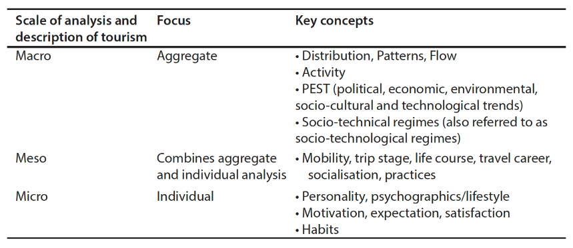
Scales of analysis in tourism and key concepts at each scale

Slide 6
International travel
A range of factors:
Not random
UNWTO predicted 1.8 billion by 2030.
Key destination areas
  East Asia and the Pacific, Americas and Europe.
  Changes over time relate to changes in travel constraints, including relating to COVID-19
  According to UNWTO by 2030 57% of international arrivals will be in emerging economies (30% in 1980) and 43% in advanced economies (70% in 1980).

Slide 7
Wild Card Events
High magnitude, low frequency events:
World wars or major international conflicts affecting generating regions and/or destinations, e.g., including the impact of sanctions;
Serious economic depression or period of severe recession over a large number of countries;

Slide 8
Wild Card Events
High magnitude, low frequency events:
Rapid increase (or fluctuations) in the price of a major energy source that is used for transportation, particularly oil, as well as the overall costs of energy; and
Outbreaks of contagious disease, e.g., COVID-19.
Disasters, such as tsunami, earthquakes and floods are more regional in scope

Slide 9
Inertia
Strong year on year stability in tourism due to
Information feedback
Distance
International connections
Attraction
Relative cost
Intervening opportunities
Image
Culture

Slide 10
Distance as factor in tourism
Travel and locational decisions (e.g., business location) are generally taken in order to minimise the frictional effects of distance, with some destinations being more accessible than others
‘Laws’ of tourism are focused on this issue of distance
Time, economic and perceptual distance are also extremely important influences

Slide 11
Describing Tourism
There are many different ways of trying to categorise tourism:
Mass and alternative
Special interest
Gray’s wanderlust and sunlust
Cohen’s classification
Plog’s classification
Classifications by motivations

Slide 12
Mass & Alternative Tourism
mass tourism refers to the production of industrially organised tourism that supports the movement of large numbers of people

Slide 13
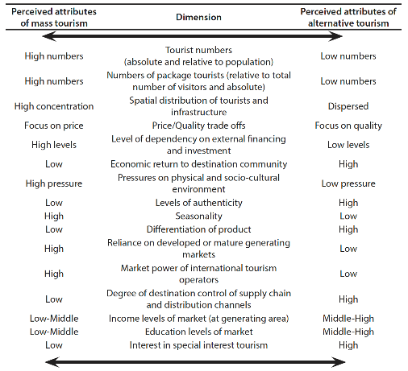
Perceived attributes of mass and alternative tourism

Slide 14
Characteristics of Mass Tourism
Highly seasonal tourism demand
Middle and low class tourists from urban-industry areas
Large numbers of tourists in ratio to locals
Spatial focus on a few areas within the destination, associated with spatial concentration of facilities
Exploitation of local values, behaviours and languages
Organisation by international tourism operators
Exploitation of natural resources
Undifferentiated products
Origin-packaged holidays
Reliance upon developed generating markets

Slide 15
Alternative tourism
Many alternative tourisms
Are mass and alternative tourism polar opposites?
On a relative per visitor basis tourism in mass tourism destinations may be extremely efficient and have smaller environmental impacts than an ecotourism destination.

Slide 16
Special Interest Tourism
Concept often closely associated with alternative tourism
SIT occurs when travel motivation and decision making is primarily determined by a particular special interest, that is often associated with ‘serious leisure’
  just attending at particular attraction or engaging is a specific activity does not make it a special interest

Slide 17
Micro-scale approaches
typologies of tourists that focus on psychological types or personality traits:
  “wanderlust” / “sunlust”
  “psychocentric”, “midcentric” and “allocentric”
Motivational studies: “push” and “pull”
  in some cases the destination may be incidental to the trip!

Slide 18
Meso-Scale Approaches
Interested in changing patterns over time:
  Life course approach – emphasizes that changes in one dimension of the household-aging process are linked to changes in other dimensions, e.g., employment, location, in seeking to explain behaviours
  Cohort analysis, e.g., comparing different generations of tourism behaviour
In both approaches travel is regarded as more routine

Slide 19
Transitions/events that affect travel careers
Leaving parental home
Sexual union
Career
Family
Children (income high/low)
Career promotion
Divorce or separation
Cohabitation and/or second marriage
Retirement
Bereavement or income collapse
Frailty or chronic ill health.

Slide 20
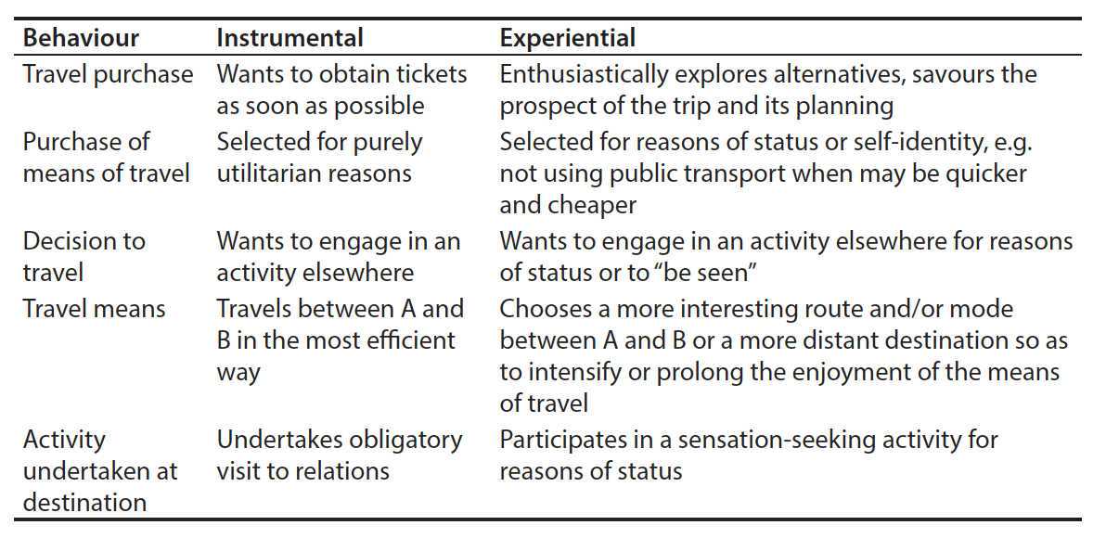
Instrumental and experiential motivations in tourist travel behaviour

Slide 21
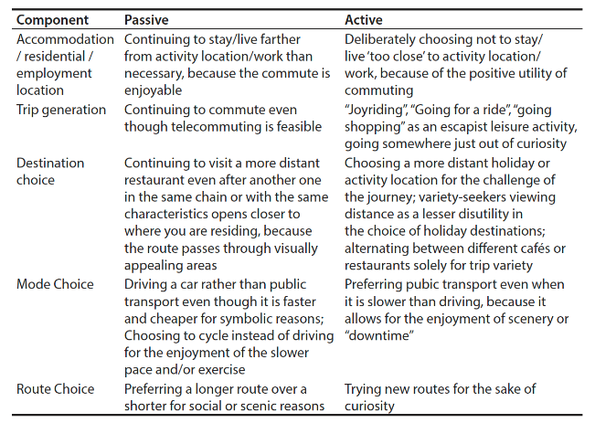
Active and passive implications of intrinsic motivations on components of tourist behaviour

Slide 22
Summary of Key Points
Tourism is characterized by a great deal of inertia
There are economic, spatial and social explanations for international tourist patterns and flows
Wildcard events are key factors affecting tourism growth
Mass and alternative tourism are normative concepts
The categorization of various types of special interest tourism is frequently confused

Slide 23
Summary of Key Points
Micro-level (psychographic and motivational) approaches focus on describing individual travel behaviour
Micro-level approaches do not sufficiently account for changes over the lifecourse of an individual.
Lifecourse approaches that give an appreciation of the cohort (generational) dimensions of tourism behaviour

